Slide 1

Eng/ Mahmoud Hammam
Introduction to neural Networks
Section 1

Slide 2
Agenda
1- What are neural networks ( Definition, Structure, terminologies , Applications)
2- Its applications
3- Logic Functions

Slide 3
What are neural networks
Are a subset of machine learning and are at the heart of deep learning algorithms. Their name and structure are inspired by the human brain, mimicking the way that biological neurons signal to one another.

Slide 4
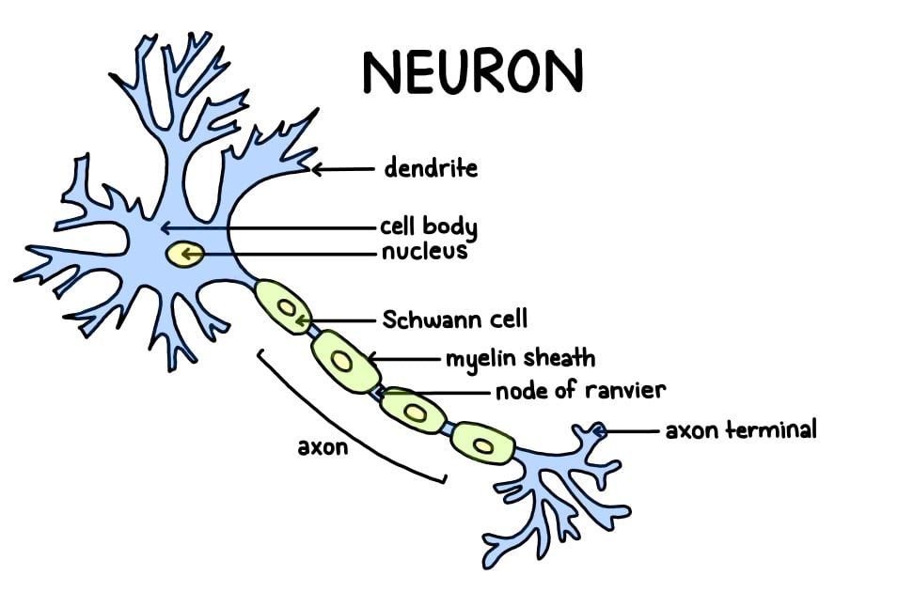
Neurons Structure

Slide 5
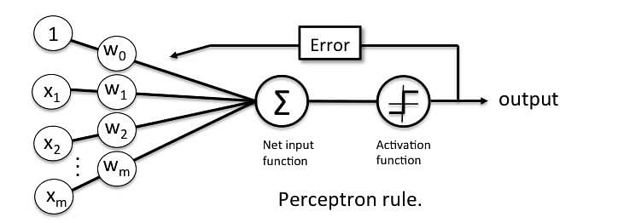
What is perceptron?
A neural network unit that does certain computations to detect features or business intelligence in the input data.

Slide 6
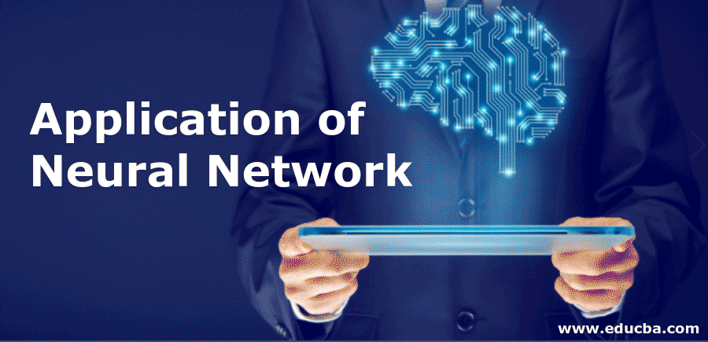
Applications on Neural Networks
image recognition, speech recognition, machine translation, and medical diagnosis

